Slide 1

Web App hosted on AWS Elastic Beanstalk
Project 3 – Group 9

Slide 2
Contents
Introduction
AWS Services
Technologies
Live Demo
Questions
System Design
System Architecture

Slide 3
Introduction
Re-designed CSCI website.
Created static web pages of the existing pages.
Added a dynamic GA/TA Application page.

Slide 4
AWS Services
Hosted the web app on AWS Elastic Beanstalk (EB).
Saves time as setup environments are readily available on AWS EB.
Easy to scale and manage the web applications.
AWS EB tools help to monitor the health of the deployed app.
Overall, an easy to use cloud computing service.
Notes:
Saves time as setup environments are readily available in AWS EB. => AWS Elastic beanstalk can take a lot of the setup work out of development/deployment and can save developers and companies time and hassle.
Example: One click Database setup in our project, one click node environment set up in our project
Easy to scale and manage the web applications. => Easy to increase the resources allocated to the web app
AWS EB tools help to monitor the health of the deployed app. => It provides tools in the form of Amazon CloudWatch to monitor the health of deployed applications.
Example: The AWS EB shows the health of the deployed app.

Slide 5
System Design
Node JS Environment on AWS Elastic Beanstalk.
Web API
Elastic Beanstalk loads the views to the internet
Serves the static web pages.
Connects to RDS DB
Saves the application data.
Saves the uploaded resumes.

Slide 6
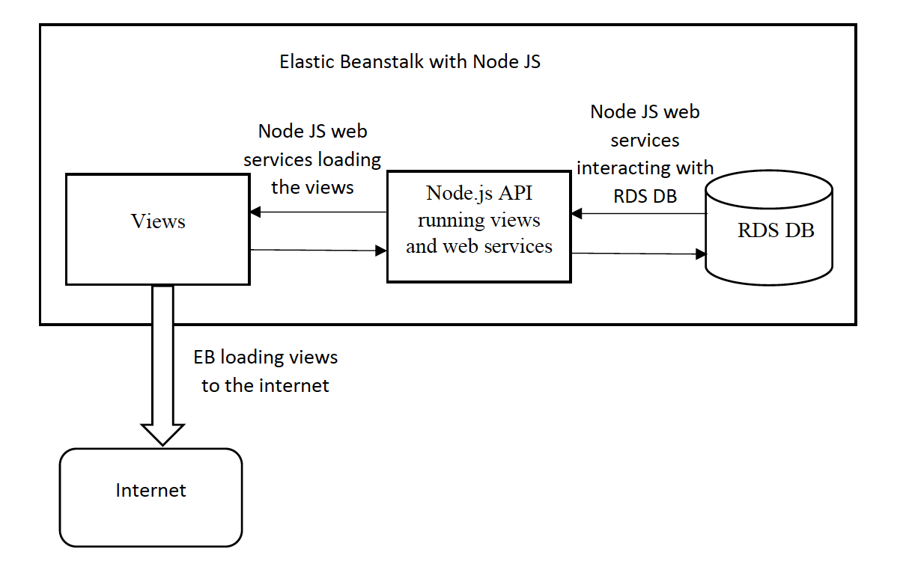
System Architecture
Notes:
Node js is framework and we used express js library is used to run server
We have used Node js to run webservices with help of express js
We have used Express js to run webservices with help of node js framework. These as well as web API
Node and express on port 8081
Webservices will connect to db and database will save data whenever we save in the form we make API calls which actually stores data into database

Slide 7
Technologies
HTML, CSS and JavaScript
Node JS
Express JS
RDS DB with MySQL
Multer

Slide 8
Live Demo
Web app hosted on AWS EB is live here.
Users can apply for a GA/TA application.
RDS DB saves the user data.
Uploaded resumes are stored in project structure.

Slide 9
Questions???

